Slide 1
Montenegro culture – unique tradition and customs of our country
Lana Tomašević, IX-1

Slide 2
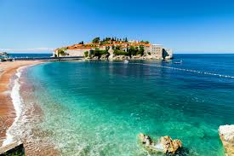
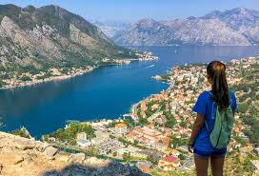
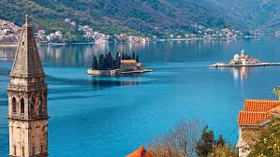
Montenegro culture
Montenegro is a country of great interests and diverse cultures, influenced by its location, at the junction between the East and the West. Our country has been a meeting point of different cultural and religious influences over history, leaving us with a rich cultural heritage.
Traces of Mediterranean, Central European, Eastern European and Oriental influences can be found in modern-day Montenegro. All of these combined, with a special Montenegrin twist, create a culture that is fascinating, charming and unique.

Slide 3
Montenegro culture
In general, the Montenegrins are very proud of their culture and speak of their country with an intense passion, because the Montenegro culture truly is a definition of their national and ethnic belonging. Traditions, art, music, language, food, and drinks are the major composites of the culture in Montenegro and make the base for those who wish to visit and understand today’s country.

Slide 4
Culture in Montenegro – the glimpse of colorful history
For a country small in size, Montenegro has a very long and eventful history. Taking a look at the nation’s history is crucial in order to get a better idea of what Montenegro culture really means. This interweaving of cultures influences in this region started a long time ago.
The Illyrians were the first known people to inhabit the region, arriving during the late Iron Age. Since then, many different tribes and nations have tried to make this hidden gem home. Greeks, Celts, Slavs, Romans, Ottoman Turks and Venetians ruled the region for nearly three centuries, contributing greatly to the beauty of Montenegro’s architecture.
Montenegro culture and it’s identity has evolved from this. Montenegrins are proud, generous, welcoming and open to everyone. Combining Mediterranean charm with Balkan passion, it’s no wonder why Montenegro has slowly emerged as one of the leading tourist destinations in Europe.

Slide 5
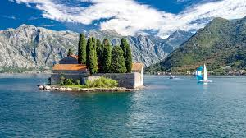
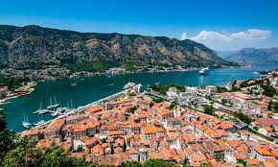
Charming centuries-old architecture – one of the symbols of Montenegro culture
If you choose the Montenegrin coast as your starting point, you will have the opportunity to see direct influences and legacy of Mediterranean culture, numerous ancient monuments, historical sites from the Roman era or early Middle Ages.
Examples of mesmerizing beauty can be found in most of the Montenegrin cities along the coast. The highest concentration of the artistic and cultural wealth was recognized in the Kotor Bay, so the town of Kotor was included in the UNESCO list of cultural heritage. Make sure you include this city to your itinerary when visiting breathtaking Montenegrin riviera.

Slide 6
Charming centuries-old architecture – one of the symbols of Montenegro culture
One of the most visited attractions in Montenegro is the Cathedral of St. Tryphon’s in Kotor. This Catholic cathedral was consecrated in 1166 and reconstructed a couple of times after earthquakes. St. Tryphon’s Cathedral is home to a rich collection of art paintings preserving the works of Marin Lovra Dobricevic, Tripo Kokolj, Paolo Veroveza, Hieronim Santa Croce and other great Montenegrin artists.
A big number of religious monuments is also well preserved. The monasteries of Morača, Piva, Sveta Trojica (Holy Trinity), Đurđevi stupovi, Savina and Ostrog – attracting people from around the world with its exceptional spiritual power and the unique ambiance. Other significant monuments include King Nikola’s Palace in Cetinje, Church of Our Lady of the Rocks and Church of St. Maria in Punta.

Slide 7
Montenegro culture is vibrant too – symboiss of art and music
Art and literature hold a special place and are an important part of the national Montenegro culture and identity. They mark great artistic achievements even though they tend to be less commercially known in the rest of the world.
There is a long history of arts including painting, sculpture and poetry and film. The country’s turbulent history has largely contributed to the famous epic poetry which is closely connected to another significant element of the Montenegro culture: gusle. Gusle is a stringed musical instrument originating from Montenegro. Without it, no story about Montenegrin music and folklore would be complete.
Montenegrin art in all its forms can be found in museums across the country. From literature to sculpture and painting, there’s a lot to be discovered. Capital city Podgorica is home to The Montenegrin National Theatre. The jam-packed festival calendar, especially during the summer months, attracts thousands of locals and tourists each year.

Slide 8
Culture in Montenegro – authentic cuisine and drinks
Montenegrin cuisine is wide and varied. It has been influenced by different nations that ruled Montenegrin territory throughout history. Montenegro is not a very large country but you can still notice regional differences when it comes to food and cuisine. Naturally, delicious seafood dishes can be found everywhere along the coast, while the mountainous regions of Montenegro are known for more meat-based dishes.
Njeguši is a tiny village in southern Montenegro, within the Cetinje municipality. It is located on the slopes of Mount Lovćen, within Lovćen national park and it is a hot spot on the culinary map of the county. It’s a birthplace of three worldwide famous Montenegrin dishes – Njegusi Proscuitto, Njegusi steak and Njegusi cheese.

Slide 9
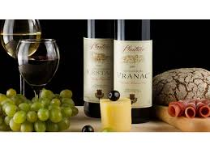
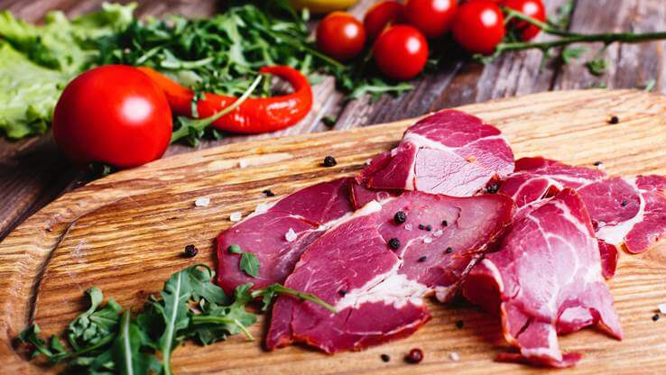
Culture in Montenegro – authentic cuisine and drinks
Another important aspect of every country’s culture is the preparation of traditional alcoholic beverages. There is a long tradition of making domestic, exceptional wine in Montenegro, so we can say Montenegro is also an ideal destination for all the wine-lovers. The famous Montenegrin white and red wines are produced from sweet and tasty grapes and adored by tourists and locals alike.

Slide 10
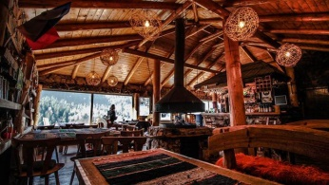
Culture and traditions
Montenegro is a country of interesting and unique traditions where customs are passed down from generation to generation. These traditions reflect the country’s past and are one of the things that make the country so appealing to all its visitors from all around the world..
All the guests and visitors to Montenegro are always paid special attention. The famous Montenegrin hospitality can be felt everywhere in the country and it’s something we are really proud of. By an old tradition that is still present today, if there is a guest in your house for whatever reason, make sure to offer them food or drinks.

Slide 11
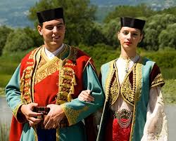
…
The other visible aspect of the Montenegro culture is the the traditional costume – it has always been an important segment of Montenegro culture. The roots of this remarkable tradition go way back in the past. Made from high-quality materials, combined with silk and golden treads, in bright colors – it is considered to be one of the most beautiful national costumes in the world, worn during special occasions and holidays.

Slide 12
Culture of Montenegro as one of its’ most important assests
The country boasts an incredibly diverse cultural scene.
Culture is an important tourism asset because it differentiates one place from the next, and it’s safe to say that Montenegro has got a lot to offer its visitors. There is a rich cultural life not only in the country’s major cities, but in virtually every corner of the land.
Montenegro is an excitingly colorful country. Throughout history, Montenegro culture has resided at the crossroads of various influences, which left a big mark on today’s cultural climate of the nation. It possesses outstanding traditions in gastronomy, winegrowing and other cultural segments in richly diverse regions, and proud people who are friendly and welcoming.

Slide 13
…
Thanks to its size, it makes a perfect destination for your dream-holiday because various landscapes are easily accessible.
You will be amazed by breathtaking scenery, distinctive culture and tradition offering an unforgettable holiday experience.
Have you already fallen in love with it?

Slide 14
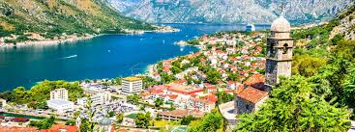
…
THANK YOU FOR YOUR ATTENTION

