Slide 1
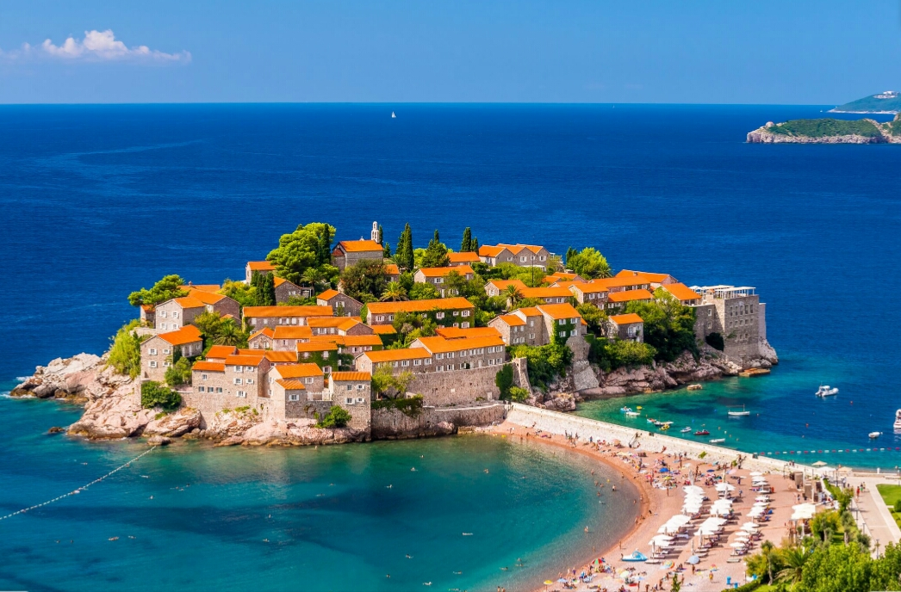
TRADITIONS and culture IN MONTENEGRO
Martina Dubak IX5

Slide 2
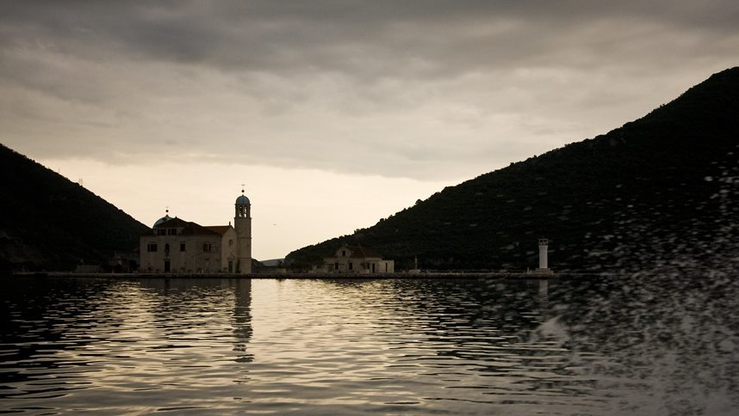
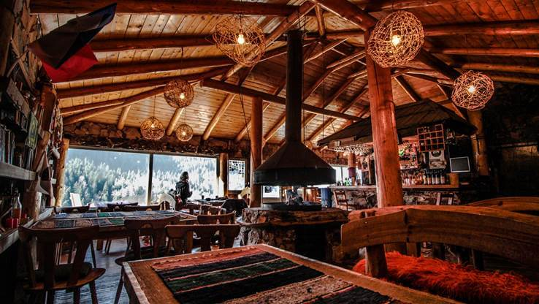
Culture of Montenegro
*The culture of Montenegro is as pluralistic and diverse as its history and geographical position would suggest. Montenegro's culture has drawn influences mainly from Ancient Rome, Christianity, Islam, the Byzantine Empire, the Ottoman Empire, the Republic of Venice, Austria-Hungary, and Yugoslavia.
*In general, the Montenegrins are very proud of their culture and speak of their country with an intense passion, because the Montenegro culture truly is a definition of their national and ethnic belonging. Traditions, art, music, language, food, and drinks are the major composites of the culture in Montenegro and make the base for those who wish to visit and understand today’s country.

Slide 3
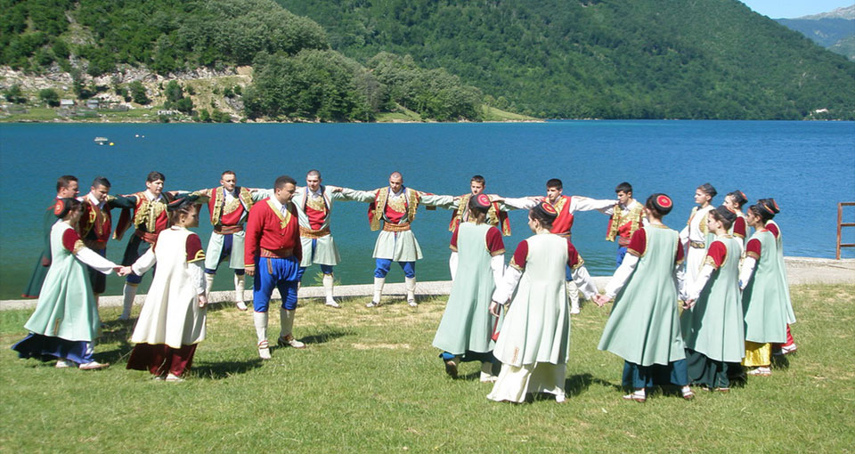
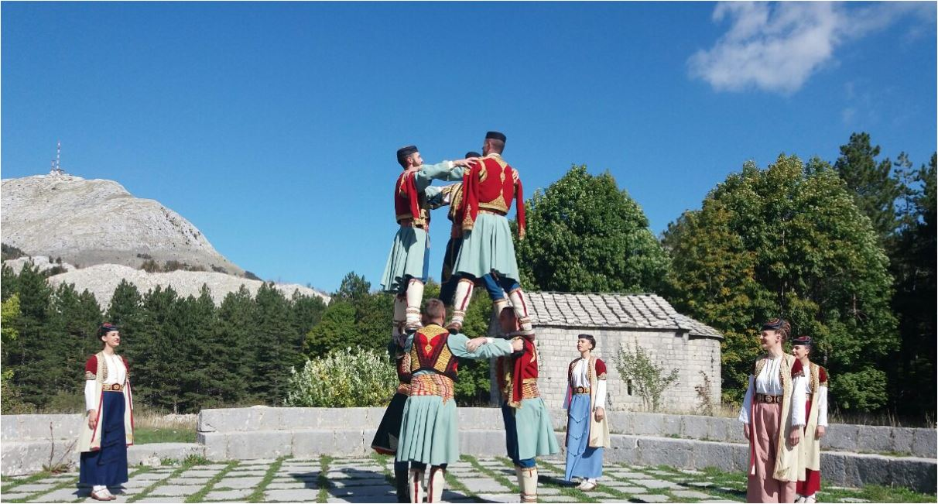
Traditions in Montenegro
Folk dances
The traditional folk dance is a circle dance called kolo , which is common among Montenegrin,Serbs and Macedonians. It is a collective dance, where a group of people (usually several dozen, at the very least three) hold each other by the hands or around the waist dancing, forming a circle (hence the name), semicircle or spiral. It is called Oro (or the „Eagle dance“) in Montenegro. Similar circle dances also exist in other cultures of the region.

Slide 4
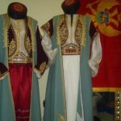
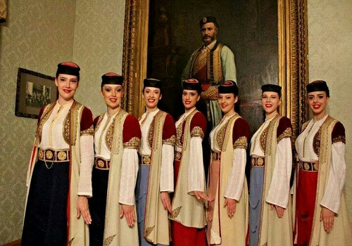
Female folklore Costume
The skirts were usually made of flax and of hemp; festive skirts were made of silk and damask, and were usually decorated with lace or golden embroidery. The skirts were buttoned with buttons, and “ambreta’s” which had both decorative and useful function. Rasa is a clothing item which was worn over the white shirt. Rasa was made of different kinds of wool. Skirt was the dressing item which women who had “rasa” had, and who were members of the richer class of immigrants. They were made of “indijana”, silk “kambelot” and other materials.
The belt is a part of traditional costume. Wide belts are made of wool. Later they were replaced by “jakicar”, a hard leather belt which was decorated with red color. Then the belt was usually made of linen or flax. The belt was buttoned with buttons or a buckle or, what was usually the case, it was simply tied around the waist and was usually 6 to 8 cm wide. What was really characteristic for Montenegrin folk costume is “cemer”. It replaced “jakicar”. It is an easier female belt which is decorated with silver filigrees and has two buckles decorated with various stones (most often those are green or dark red stones). Cemer could else be found made in forged shape. Below the old heavy belt there was another one, known as “zenski trak” (female band). “Zenski trak” is a coarse fabric band which is up to 6cm wide and 5 and more meters long with which women wrapped their waist in order to protect themselves from the pressure of the heavy belt which they wore. Apron was considered an unavoidable part of the traditional Montenegrin folk costume. Aprons were worn with the traditional costume and were usually intended for the everyday use. Such aprons were made of “tela” and “indijana”. There were those aprons which were worn for festive occasions and such aprons were decorated with silk and golden embroidery. Jecerma is a kind of a short vest, which goes down to the waist which was made with buttoning and without it and was usually made of coarse fabric or velvet. Kamizola is also a kind of a vest which was worn over the shirt. It was made of silk and damask. This vest only had women from high social classes. Zubun was made of coarse fabric, “bombazine” and velvet. Zubuns in Montenegro were made in various lengths. They were made without sleeves and with them and they usually had buttons on them with which they were buttoned. Dolama is a kind of an upper dress which was most often made of coarse fabric and had a festive usage. The length of dolama usually reached the knees, though sometimes it could go even below them, and dolamas always had sleeves. They were decorated with golden buttons or golden ropes. Bran is a wide female dress. It was worn over the shirt, and it is made of an upper and lower part – from “stan” and of skirt. “Stan” was tight and close to body, while the lower part was made of 5 folds

Slide 5
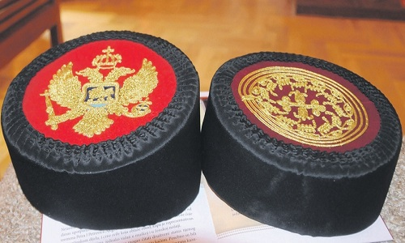
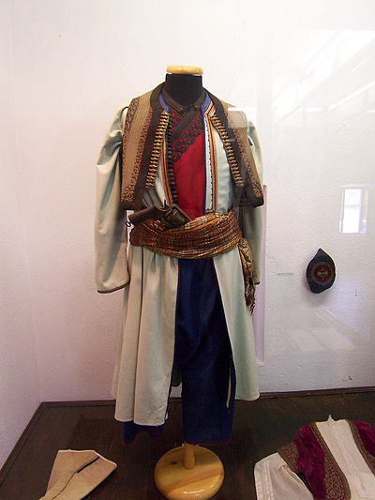
Male costume
If we start by the order of dressing in first place would come knee socks. Knee socks are a kind of socks which strongly tighten the calves. For making of these socks a great skill is needed, and what needs to be pointed out is that no matter the experience and years for putting on of the knee socks it takes a lot of time. Knee socks need to be tightened strongly in order for man’s easier and safer movement, which was extremely important for Montenegrins who moved around the stony Montenegro. Except the knee socks there were the so called “bjecve” which had a slit on the side, and their rims were hemmed with red or dark blue coarse cloth. Pants were dresses immediately after the knee socks and they should overlap one part of the knee socks. Very often pants and knee socks were tied with a cord so that they wouldn’t separate, and for that people made special hooks on the knee socks. Pants in ordinary Montenegrins were white and they were made of coarse linen and water proof cloth (coja). Pants near the waist were wide, while below the knees they were shrunk. Montenegrins had a belt in which there was a wreath through which a rope went through in order for the pants to be tied around the waist. Male shirt had a collar and a slit on the chest which was closed with buttons. The shirt was drawn in the pants and most often it was a white shirt) rarely could you find a Montenegrin in a colorful shirt). The shirt was an obligatory part of the Montenegrin male costume and at the festivities it was always tied. Except the shirt male folk costume, its upper part, was made of “gunj” (long peasant jacket). Gunj had short tassels which on the chest were moved apart. Montenegrins wore this short coat whose ends crossed one over the other and it was buttoned with copper buttons. Gunj was replaced with “dolama”(dolman), which has the sleeves below the armpits and up to the fist they are almost opened, so that they can be thrown back. In that way the hand stays solely in the shirt. That was of great importance and very characteristic for Montenegro, because in that way the suites, the folk garment could be made for all seasons. When it was summer they didn’t use the sleeves of dolmans, but they would throw the sleeves behind the back, and when it was winter, Montenegrins would put on the sleeves of dolmans. A dolman can usually be found in Montenegro in green color, and it is made of coarse linen or waterproof cloth (coja). The ends of the dolman (sleeves and the corners and tassels) are decorated with dark red color. Below gunj they wore “dzemadan”, which was made of red coarse linen and was usually embroidered with on sides with some cotton or silk braids of black or golden color. That is a vest with tassels which came one over the others, and it was buttoned with four buttons (made of metal) and with black knots made of silk rope. Dzemadan was worn over the chest, and it went all over to the throat. The rims of dzemadan on tassels are also decorated with knots or with golden embroidery.

Slide 6
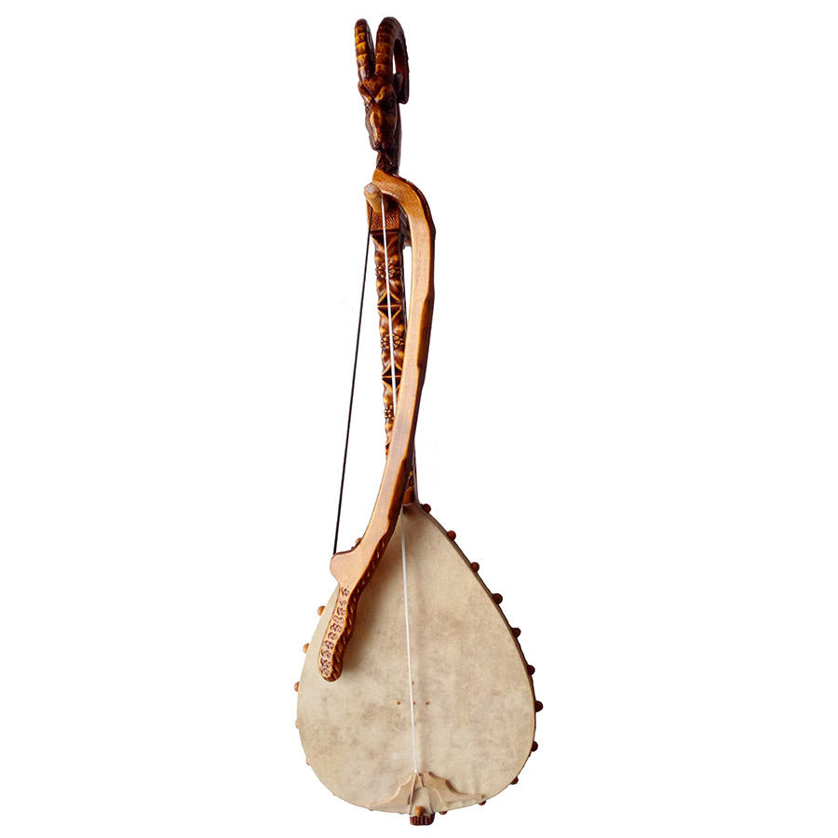
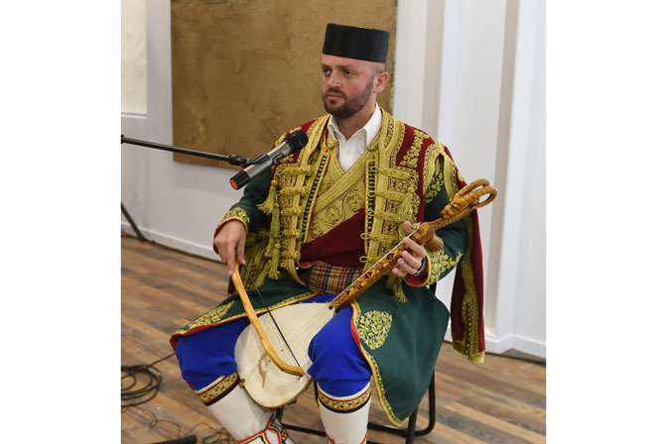
Epic songs
Montenegrins' long-standing history of struggle for freedom and independence is invariably linked with strong traditions of oral epi poetry.Traditionallyy, they are delivered to the audience accompanied by the music produced by a gusle a one-string instrument played by the story-teller (guslar), who sings or recites the stories of heroes and battles in decasyllabic verse. Historically, these songs have had an immense motivational power over the population. The guslars commanded almost as much respect as the best of wariors,as they were as much the authors, thus history writers, as they were interpreters. Presently, these traditions are somewhat livelier in the northern parts of the country (also shared with people in eastern Herzegovina , wester Serbia , and central Dalmatia).

Slide 7
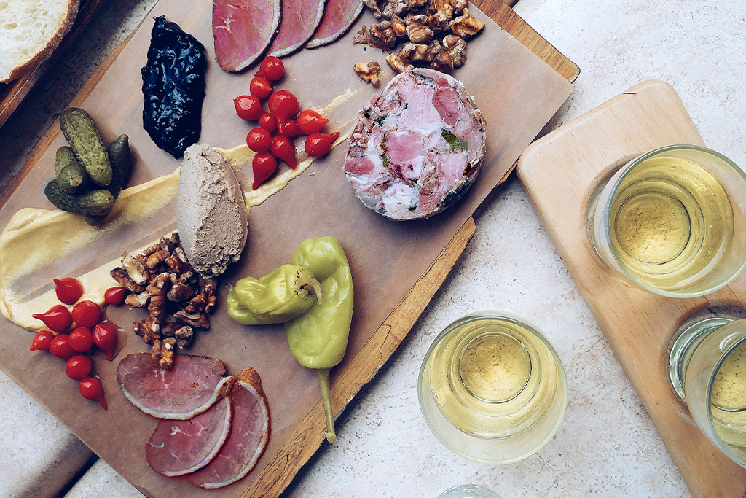
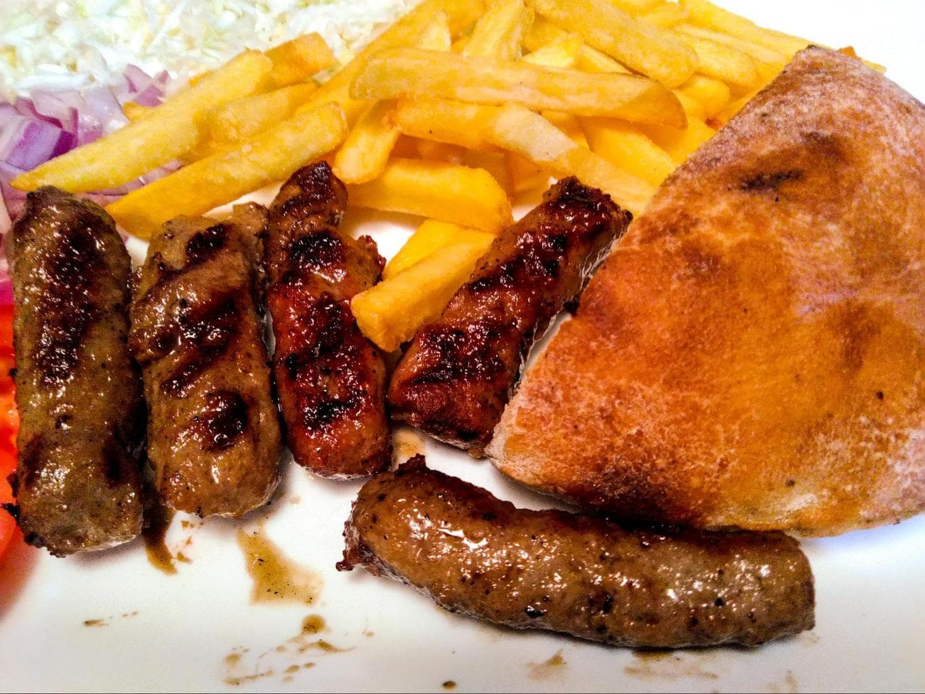
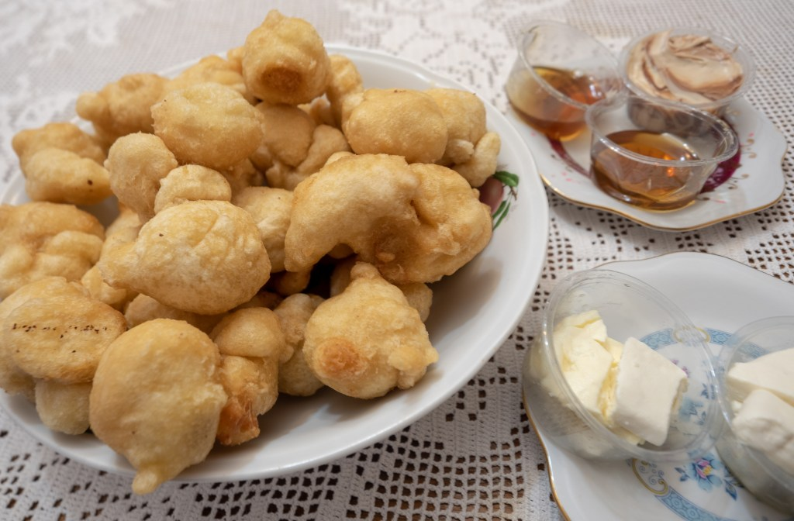
Montenegrin cuisine
Montenegrin cuisine is a result of Montenegro's geographic position and its long history. The traditional dishes of Montenegro's heartland, and its Adriatic coast have a distinctively Italian flavour which shows in the bread-making style, the way meat is cured and dried, cheese-making, wine and spirits, the soup and stew making style, polenta, stuffed capsicums, meatballs, priganice, japraci, raštan, etc.
The second large influence came from the Levant and Turkey, sarma, musaka, pilav, pita, burek, ćevapi, kebab, Turkish sweets like baklava and tulumba, etc. Hungarian dishes include goulash, satarash, and djuvech, which are also very common. Last but not least, Croatian cuisine made its mark mostly in the desserts department.
Additionally crêpes, doughnuts, jam, myriad types of biscuits and cakes, all make a contribution to the average Montenegrin's waist-line. Vienna-style bread is the most prevalent type of bread in the shops.
Montenegrin cuisine also varies geographically; the cuisine in the coastal area differs from the one in the northern highland region. The coastal area is traditionally a representative of Mediterranean cuisine, with seafood being a common dish.

