Slide 1
My city
Anja Čabarkapa VIII-3

Slide 2
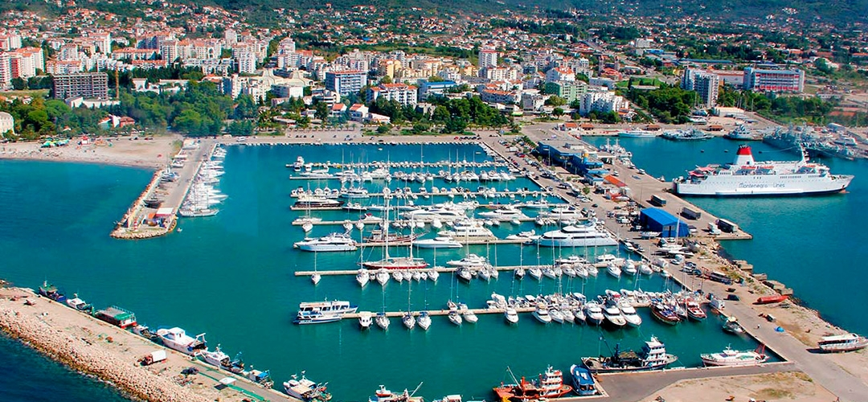
Bar,Montenegro

Slide 3
Bar,Montenegro
The city of Bar is located on the coast of Montenegro. It is 75 km away from the capital, Podgorica. The city has 13,719 inhabitants and the municipality has 83 settlements and 40,037 inhabitants. The municipality is divided into 12 local communities. The wealth of this city consists of 25 nationalities inhabiting this area. Today's postcard of Bar consists of numerous facilities, sports fields, marinas, beaches and ports. The port of Bar is the largest Montenegrin port. Bar is the connection of Montenegro with the world, because it is a border municipality, which is connected to Italy by the Adriatic Sea.

Slide 4
Geography of the city
Bar municipality is located in the south of Montenegro, between the Adriatic Sea and Skadar Lake. The town itself is located at 42°6‘ latitude and 19 ° 6 'longitude,at an altitude of 4 meters. Bar has over 270 sunny days, which makes it one of the sunniest cities in Europe. The city of Bar is surrounded by numerous mountains. The largest is Rumija, which is located at an altitude of 1,595 m. Next to it, there is, on one side Sutorman whose peak, "Broad side" at an altitude of 1,185 m. On the other side is Lisinj with the highest peak "Loška" at an altitude of 1,353 m. In the vicinity of Bar there are several smaller rives.In 2010.,over the 142.ooo tourists visited Bar,which makes it one of the main tourist destinations in Montenegro.

Slide 5
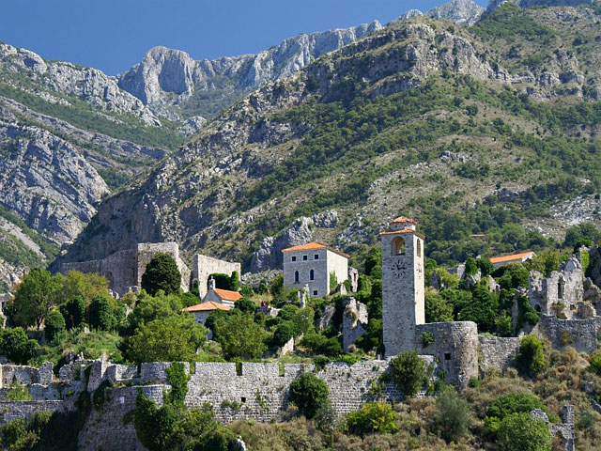
Old Town

Slide 6
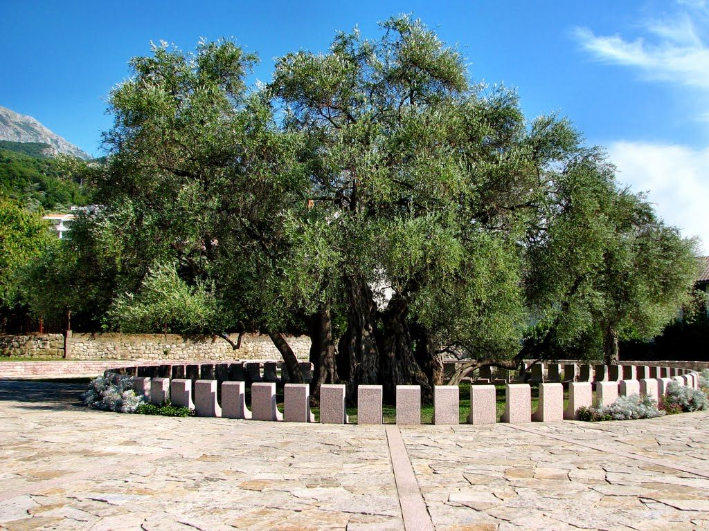
Old olive

Slide 7
Old Town
The old part of the city, Stari Bar, is mentioned in documents dating from the 9th century. The well-preserved remains of the walls and fortresses, as well as the beautiful view of the entire city and its surroundings, oblige the traveler to visit it. At the entrance to the city there is an olive tree between 2,000 and 2,500 years old. This is the oldest olive tree in the world.The tree still bearing fruit.Next to Stari Bar, there is the Bar Aqueduct,only remaining aqueduct in Montenegro, and one of the three largest in the former Yugoslavia. It has 17 arches. Tito visited Bar 4 times: 1946, 1959, 1969, 1976. The old medieval city is among the largest archeological sites in the walls in the world, situated on a huge stone massif, inaccessible from the east and south, while gently sloping to the west and northwest. It is located in the southeastern part of the coast, 4 km from the sea. It stands out for its unique position and the richness of the monument's treasure. Stari Bar leaves every visitor amazed by the beauty of its natural environment and the witnesses of its centuries-old existence.

Slide 8
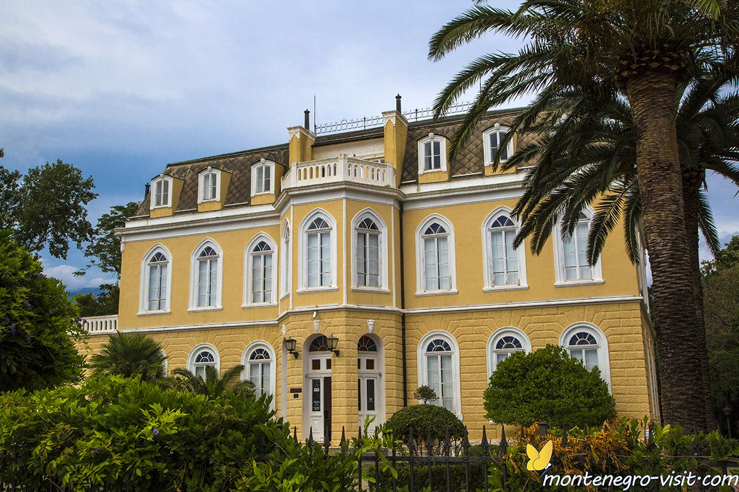
Castle of King Nicholas

Slide 9
Castle of King Nicholas
The castle of King Nikola was built in 1885 on the sea shore. It was constructed by the King,and was a gift to his daughter Princess Zorka and his son-in-law Prince Petar Karadjordjević.It consists of a large and a small castle, a chapel, a watchtower, a winter garden and a park. In front of the building was a wooden pier, for mooring ships. There is also a large flower garden,constructed in the interesting shape,which was a gift from Italian King Emanuel.It is now a restaurant called Knjaževa bašta(The Duke’s Garden).Corrently ,the place complex represents the Homeland Museum of Bar, used for various cultural evens.

Slide 10
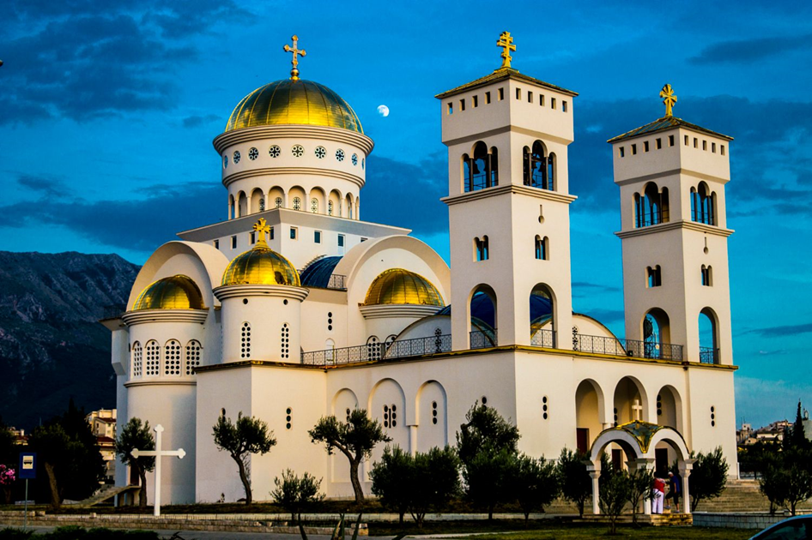
Church of St. John Vladimir

Slide 11
Church of St. John Vladimir
The Church of St. John Vladimir in Bar is the largest cathedral church in Montenegro, and the third largest Orthodox church in the world, after the Church of Christ the Savior in Moscow and the Church of St. Sava in Belgrade. The first request for determining the location for the construction of the temple in Bar was submitted to the state body by the priest Bogić Femić shortly after the 1979 earthquake. The communist authorities did not approve the request, so two years later, on March 17, 1981, the initiative committee for the construction of the temple organized a protest due to the obstruction of the government. A mass rally in front of the City Assembly followed, as well as the signing of a petition, so the location for the temple was eventually obtained, about 2 hectares in the center of Bar. A concrete cross was placed on the obtained location, where evening services were regularly performed, waiting for some better time to start with the construction of the temple. Work on the construction of the Cathedral began in 2006, but due to lack of funds, the first concrete was poured into the foundation slab of the temple on July 3, 2009, after which the construction started furiously. The temple was finally completed and consecrated on September 25, 2016, on the thousandth anniversary of the martyrdom of St. John Vladimir. central dome. It is the largest temple in Montenegro, which can accommodate about 1,200 people. It is 100 square meters larger in area, and 3 meters higher than the Cathedral in Podgorica. 4,860 square meters of walls were painted in the temple, an iconostasis 18.5 m long was made and a floor mosaic of about 1,700 m² was made. The temple was painted in the traditional fresco technique. The lime used for the mortar on which the paint is applied while it is not dried, in a fresh state, should be at least 4 years old, and the older the better. Lime more than 40 years old was found in the famous limestone near Spuž, and the fresco painted on such high-quality limestone does not fade. Its maturation lasts up to 200 years. There are 11 bells on the temple, the largest of which weighs 800 kilograms. The bells are placed in two piers, dedicated to the Holy Emperor Constantine and Empress Helen, and Saints Cyril and Methodius.

Slide 12
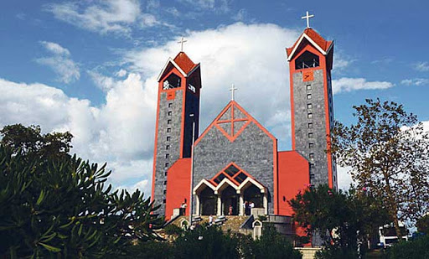
St. Peter's Cathedral

Slide 13
St. Peter's Cathedral
Concathedral of St. Petra is the second cathedral church of the Bar Archdiocese. It is located in Bar, Montenegro. It is dedicated to the Holy Apostle Peter. The cornerstone was blessed by Cardinal Theodore Edgar McCarrick of Washington on July 16, 2006, and construction began on June 30, 2010. The consecration of the concathedral took place on September 3, 2017 at a Mass served by the Archbishop of Bar and Primate of Serbia retired Zef Gashi, for whose pontificate the construction of the concathedral began. The ceremony was also attended by the Metropolitan of Montenegro and the Littoral, Amfilohije, who presented the icon of Jesus and the Mother of God to the Archbishop of Bar, Rrok Gjonlleshaj. The construction of the cathedral cost 3,500,000 euros, and the donors were various church organizations and individuals from the Vatican, Italy, Germany and the United States. The designers are architects from Foggiae Nicola Danza and Rodolfo Mancano. The front door, the altar, the pulpits, the cross above the altar ... are the work of the Studio of Applied Arts of Igino Legnaghi from Verona. The bronze door was cast in the workshop of Pjerin Kolinikaj in Tirana. The bells, placed on two bell towers, were cast in Innsbruck, by the famous Grassmayr company. The stained glass windows are the work of Rassom Giorgio and Roland Tesadri from Italy, and were made using the laser technique on glass, especially for this occasion, in Bolzano. The marble is from Montenegro and the chairs for priests and benches for concelebrants and ministers are the work of the company Braća Đerđi from Bibaj near Uroševac. The five-cross chandeliers are the work of the lighting company Dekor from Zabok, and the sound system was done by the company Strasser from Stuttgart.

Slide 14
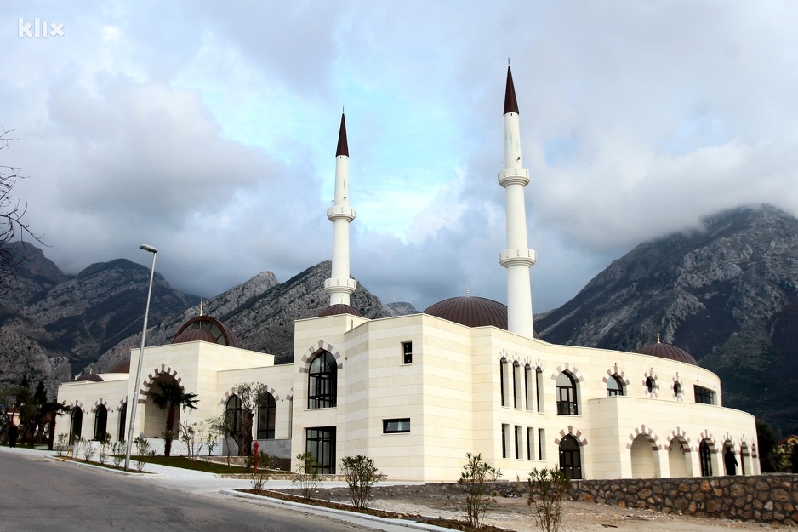
Selimiye Mosque

Slide 15
Selimiye Mosque
The Selimiye Mosque and the Islamic Cultural Center in Bar, Montenegro, are buildings that the Board of the Islamic Community of Bar began construction on July 28, 2002. The Turkish Agency for International Cooperation and Coordination TIKA has completed the works and equipped the facility, which was inaugurated on May 29-30, 2014. Orthodox Church of St. Nikola in Stari Bar is located near this mosque Selimiye Mosque in Bar. View from the place near the church of St. Sundays on Rap.The authors and leading responsible designers from 2002 to 2014 were architects and B.Sc. ing. Selim Resulbegović and Fuad Mavrić from Ulcinj. It is the largest Islamic cultural center in Montenegro, and one of the largest in the Balkans, built on an area of ​​3,950 square meters, which includes the Selimiye Mosque. The works cost about four million euros, and the facility was built on the waqf land of the Islamic Community. It was bequeathed by Fatima Omerbašić in the 19th century, for the needs of the Tuđemili congregation. The white stone was brought from Turkey, and the works lasted twelve years. The name is Selimija, in memory of the first mosque built in the Old Town of Bar, of which only the foundations have survived today. The Islamic Cultural Center consists of two wings. In the right wing there are classrooms and IT cabinets, a kindergarten with modern equipment and a playground, a library and reading room, a research center, musafirhana and muhabethana, toilets and bathrooms, offices for officials and administration of the Board. In the left wing there is a restaurant with oriental cuisine, a hall for sharia wedding, a room for simultaneous translation, a boutique with religious props, guest apartments. The opening was attended by Archpriest-Staurophore Radoman Mijajlovic, Archbishop of Bar Zef Gashi, President of Montenegro Filip Vujanovic, President of the Parliament of Montenegro Ranko Krivokapic, members of the Montenegrin and Turkish parliaments, councilors, businessmen.

